Slide 1
Digital House Appraisals
Saving Money Buying or Selling Houses

Slide 2
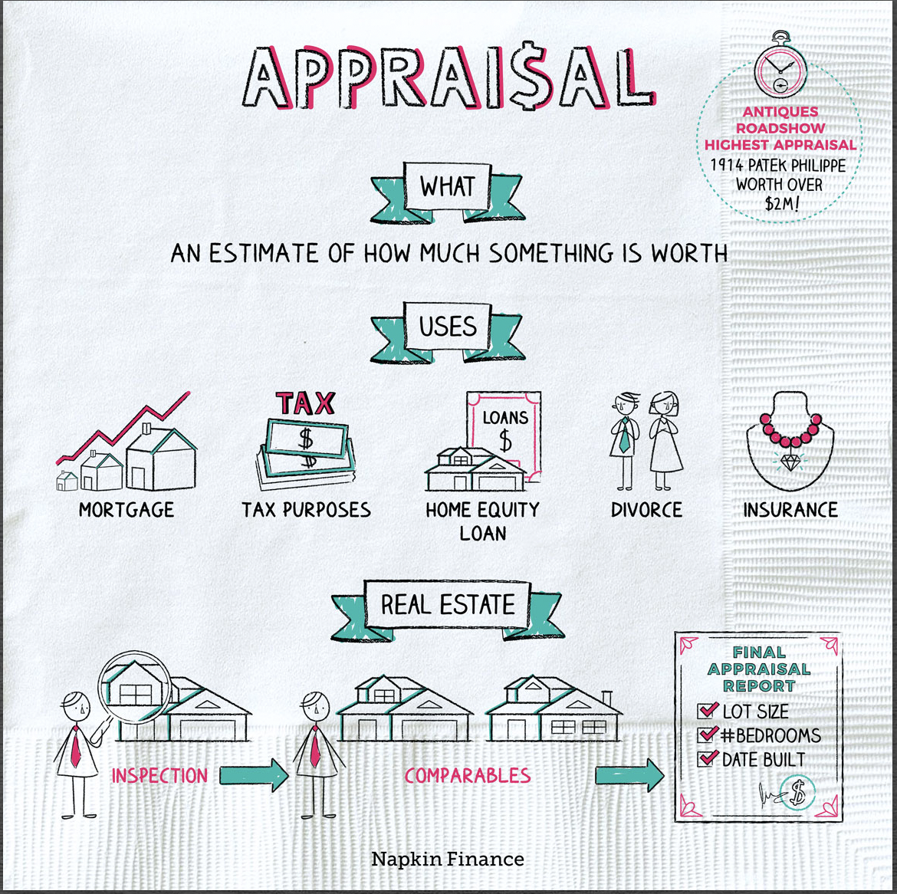

Slide 3
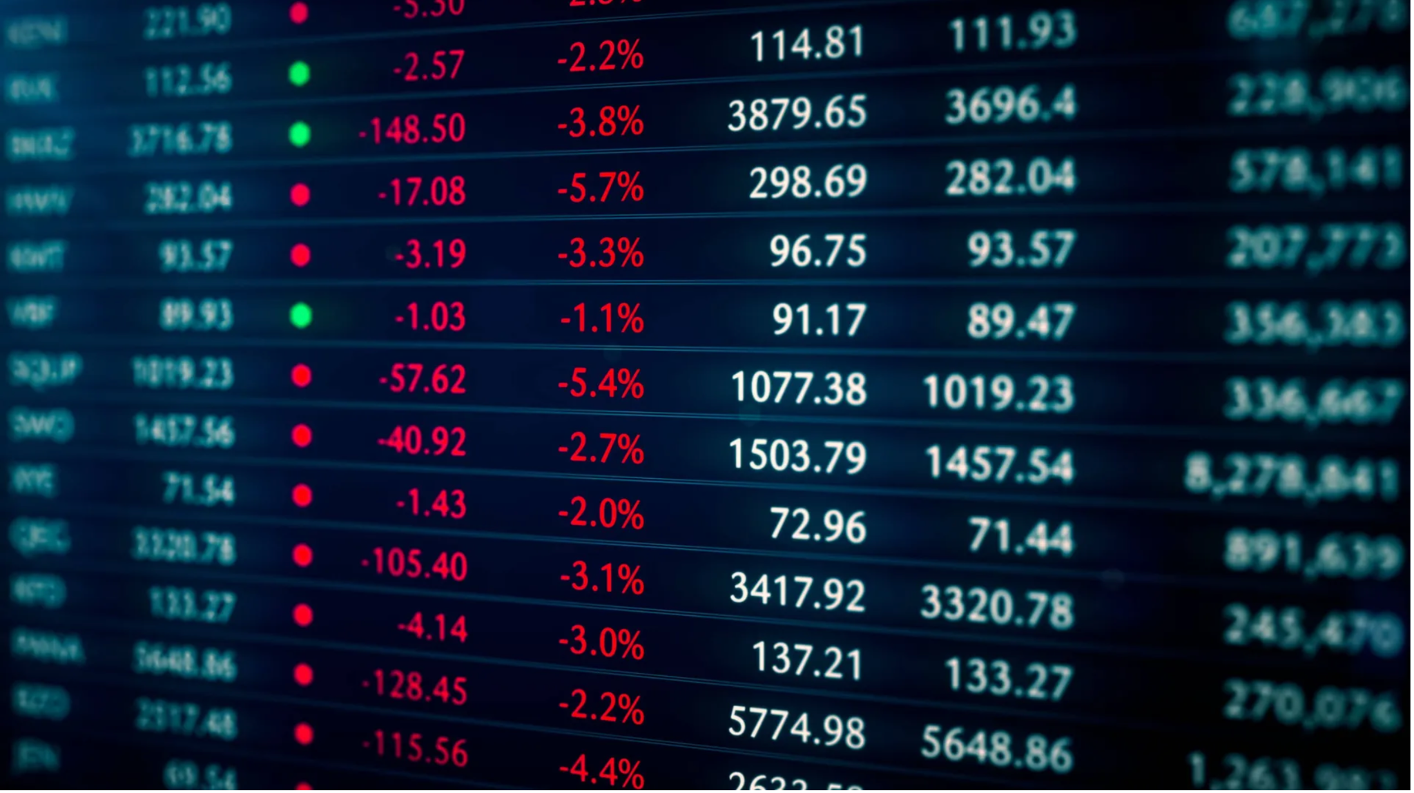
Why are Appraisals necessary?
Normally, if you need to know the value of something, you can form an estimate by looking at recent sales of similar items. For example, if you want to know the value of stock you own, you can look at its recent share price. Or if you want to know the value of your car, you can look online for recent value estimates for the same model from the same year.
But if you need to know the value of something that’s unique or that isn’t bought or sold frequently, you may need to obtain an appraisal from an expert.

Slide 4
Pricing for Appraisals
The average home appraisal cost in the Empire State is $625. The price of an appraisal can vary based on property types:
Single-Family Homes: $625
Individual Condominiums: $625
Manufactured Homes: $675
Multi-Family Homes: $825
In New York City, on average, about 2,190 homes were sold in February 2025, up from 2,071 the previous year. This represents a 5.7% increase in home sales year-over-year. The median sale price in February 2025 was $852,500, a 8.6% increase compared to the previous year.

Slide 5
Pros and Cons of Traditional Home Appraisals
PROS
You work with life experts
It takes more time to make system changes than it does with a live agent.
CONS
Could be costly
Some people might need several appraisals done on their homes to get an accurate price.
Subject to human error as it relies on human judgement

Slide 6
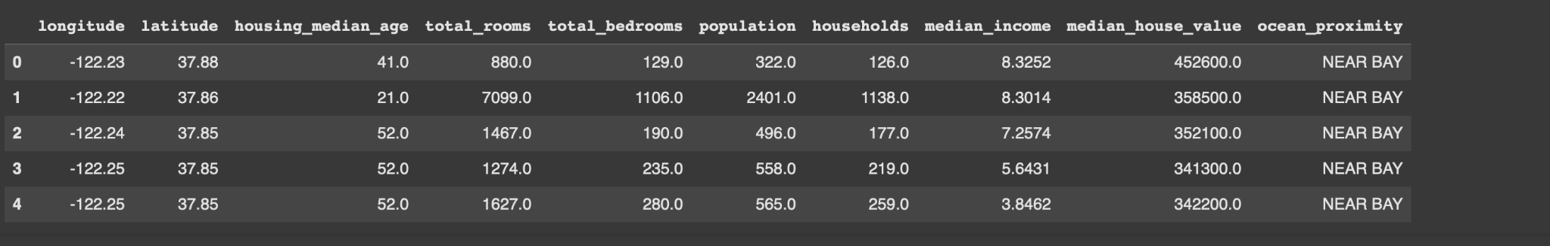
Sample of Program
'https://raw.githubusercontent.com/ageron/handson-ml2/master/datasets/housing/housing.tgz'

Slide 7

Saving Money for All :)

